Slide 1
Memory Design and Testing – EE787
Kaushik Saha
Contact: ksaha_2000@yahoo.com, mobile-98110-64398

Slide 2
Course Logistics (TBD)
Class Representative
Class Newsgroup manager –
I need a class list (Soft copy)
Grading Policy
Project
Project Review - 60
Every class will project review
every project group will present its progress every alternate weel
Project Document - 20
Majors - 20

Slide 3
Texts
Semiconductor Memories, A Handbook of Design, Manufacture and Application (2nd Ed) – Betty Prince
John Wiley & Sons UK, ISBN 0 471 92465 2; 0 471 94294 2 (pbk)
Journal articles and Web material
Course material will be made available on
USB drive
Course newsgroup

Slide 4
Agenda of Topics
1 Memory hierarchy in digital systems
2) Static RAM
a. Types
b. Overall architecture
c. SRAM Cell
i. Design
ii. Layout
iii. Noise issues and margins
iv. Assembly of core
d. Peripheral circuitry
i. Decoding
ii. Array conditioning for r/w
iii. Sensing
iv. Writing
v. Synchronisation
3) Dynamic RAM
a. Types
b. Cell design
c. Assembly of core
i. Core architectures
d. Peripheral circuitry
i. Sensing
ii. Elevated voltage supplies
e. Modern high speed DRAM
i. EDO,
ii. SDR,
iii. DDR)

Slide 5
Agenda of Topics cont’d
4) Non volatile memories
a. ROM
i. Array design
b. EPROM
i. Cell and array design
c. EEPROM
i. Tunneling phenomena
ii. EEPROM cell
1. Hot carrier based operation
2. Tunneling based operation
d. Flash memories
i. Cell operation and design
ii. Types of modern high density flash memories
1. NOR flash
2. NAND flash

Slide 6
Classification of Memories
RW | Memory | NVRWM | ROM
Random Access | Non-Random Access | EPROM EEPROM | Mask Programmed
SRAM (Static) DRAM (Dynamic) | FIFO (Queue) LIFO (Stack) SR (Shift Register) CAM (Content Addressable) | FLASH | PROM (Fuse Programmed)

Slide 7
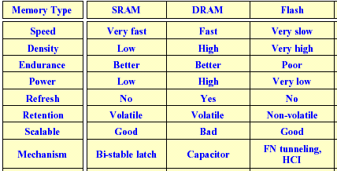
Feature Comparison Between Memory Types

Slide 8
Memory selection : cost and performance
DRAM, EPROM
Merit : cheap, high density
Demerit : low speed, high power
SRAM
Merit : high speed or low power
Demerit : expensive, low density
Large memory with cost pressure :
DRAM
Large memory with very fast speed :
SRAM or
DRAM main + SRAM cache
Back-up main for no data loss when power failure
SRAM with battery back-up
EEPROM

Slide 9
The Need for Innovation in Memory Industry
The learning rate (viz. the constant b) is the highest for the memory industry
Because prices drop most steeply among all ICs
Due to the nature of demand + supply
Yet margins must the maintained
Techniques must be applied to reduce production cost
Often, memories are the launch vehicles for a technology node
Leads to volatile nature of prices

Slide 10
Memory Hierarchy of a Modern Computer System
By taking advantage of the principle of locality:
Present the user with as much memory as is available in the cheapest technology.
Provide access at the speed offered by the fastest technology.
Processor
Control
Tertiary
Storage
(Tape)
Secondary
Storage
(Disk)
Second
Level
Cache
(SRAM)
Main
Memory
(DRAM)
Datapath
On-Chip
Cache
Registers
Speed (ns):
1s
10s
100s
10,000,000s
(10s ms)
10,000,000,000s
(10s sec)
Size (bytes):
100s
Ks
Ms
Gs
Ts
Notes:
The design goal is to present the user with as much memory as is available in the cheapest technology (points to the disk).
While by taking advantage of the principle of locality, we like to provide the user an average access speed that is very close to the speed that is offered by the fastest technology.
(We will go over this slide in details in the next lecture on caches).
+1 = 16 min. (X:56)

Slide 11
How is the hierarchy managed?
Registers <-> Memory
by compiler (programmer?)
cache <-> memory
by the hardware
memory <-> disks
by the hardware and operating system (virtual memory)
by the programmer (files)

Slide 12
Memory Hierarchy Technology
Random Access:
“Random” is good: access time is the same for all locations
DRAM: Dynamic Random Access Memory
High density, High power, cheap, slow
Dynamic: need to be “refreshed” regularly
SRAM: Static Random Access Memory
Low density, Lower power, expensive, fast
Static: content will last “forever”(until lose power)
“Not-so-random” Access Technology:
Access time varies from location to location and from time to time
Examples: Disk, CDROM
Notes:
The technology we used to build our memory hierarchy can be divided into two categories: Random Access and Non-so-Random Access.
Unlike all other aspects of life where the word random usually associates with bad things, random, when associates with memory access, for the lack of a better word, is good!
Because random access means you can access any random location at any time and the access time will be the same as any other random locations.
Which is NOT the case for disks or tape where the access time for a given location at any time can be quite different from some other random locations at some other random time.
As far as Random Access technology is concerned, we will concentrate on two specific technologies: Dynamic RAM and Static RAM.
The advantages of Dynamic RAMs are high density, low cost, and low power so we can have a lot of them without burning a hole in our budget or our desktop.
The disadvantages of DRAM are they are slow. Also they will forget what you tell them if you don’t remind them constantly (Refresh). We will talk more about refresh later today.
SRAM only has one redeeming feature: it is fast. Other than that, they have low density, expensive, and burn a lot of power. Oh, SRAM actually has another redeeming feature. They will not forget what you tell them. They will keep whatever you write to them forever.
Well “forever” is a long time. So lets just say it will keep your data as long as you don’t pull the plug on your computer.
In the next two lectures, we will be focusing on DRAMs and SRAMs.
We will not get into disk until the Virtual Memory lecture a week from now.
+3 = 19 min. (X:59)

Slide 13
Main Memory Background
Performance of Main Memory:
Latency: Cache Miss Penalty
Access Time: time between request and word arrives
Cycle Time: time between requests
Bandwidth: I/O & Large Block Miss Penalty (L2)
Main Memory is DRAM : Dynamic Random Access Memory
Dynamic since needs to be refreshed periodically Addresses divided into 2 halves (Memory as a 2D matrix):
RAS or Row Access Strobe
CAS or Column Access Strobe
Cache uses SRAM : Static Random Access Memory
No refresh (6 transistors/bit vs. 1 transistor) Size: DRAM/SRAM ­ 4-8 Cost/Cycle time: SRAM/DRAM ­ 8-16

Slide 14
Memory Interfaces
Address i/ps
Maybe latched with strobe signals
Write Enable (/WE)
To choose between read / write
To control writing of new data to memory
Chip Select (/CS)
To choose between memory chips / banks on system
Output Enable (/OE)
To control o/p buffer in read circuitry
Data i/os
For large memories data i/p and o/p muxed on same pins,
selected with /WE
Refresh signals

Slide 15
Memory - Basic Organization
S₀
Word 0
N words
M bits per word
N select lines
1:N decoder
very inefficient design
difficult to place and route
S₁
Word 1
Single
Storage
Cell
S₂
Word 2
S_{N-2}
Word N-2
S_{N-1}
Word N-1
M bit output word

Slide 16
Memory - Real Organization
Array of R x C words
S₀
------------- columns ------------ CxM
Row
Decoder
C of M bit words row 0
C of M bit words row 1
C of M bit words row 2
Log₂R
Address
Lines
------------- rows R------------
C of M bit words row R-2
C of M bit words row R-1
S_{R-1}
- - - - CxM bits - - - -
Log₂C
Address
Lines
Column Select
N = R * C
M bit data word

Slide 17
Memory - Organization and Cell Design Issues
aspect ratio (height : width) should be relative square
Row / Column organisation (matrix)
A_R = log2(R); A_C = log2(C)
A_R + A_C = N_address_bits
N = 2^{N_address_bits} = R*C
number of rows should be power of 2
number of bits in a row
sense amplifiers to amplify the voltage from each memory cell
R -> 2^{A_R} row decoder
C -> 2^{A_C} column decoder
implement M of the column decoders (M bits, one per bit)
M = output word width

Slide 18
Array-Structured Memory Architecture L address bits – K bit row address, L-K bit column address

Slide 19
Hierarchical Memory Architecture

Slide 20
SRAM Application Areas
Main memory in high performance small system
Main memory in low power consumption system
Simpler and less expensive system if without a cache
Battery back-up
Battery operated system

Slide 21
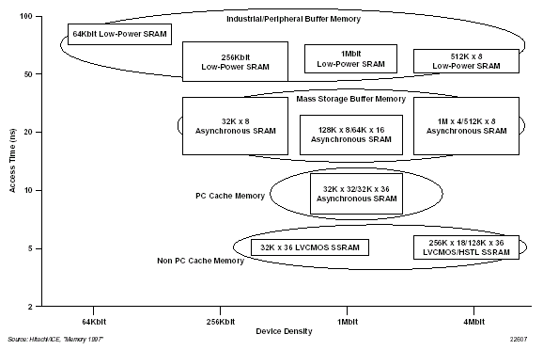


SRAM Performance vs Application Families

Slide 22
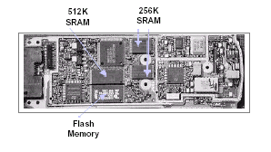
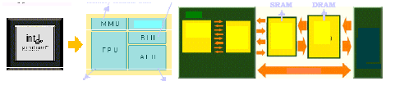
Typical Application Scenarios
SRAM
DRAM
MMU
L1
16KB
L2
256KB
64MB
BIU
CORE
I/O
PCI
ISA
FPU
ALU
i586 based PC
Hand phone and Cache

Slide 23
Overview of SRAM Types

Slide 24
Logic Diagram of a Typical SRAM (Asynch)
A0-AN
CS!
2
N
words
WE_L
x M bit
SRAM
OE_L
D
M
Write Enable is usually active low (WE_L)
Din and Dout are combined to save pins:
A new control signal, output enable (OE_L) is needed
WE_L = 0, OE_L = 1
D serves as the data input pin
WE_L = 1, OE_L = 0
D is the data output pin
Both WE_L = 1, OE_L = 1
Result is unknown. Don’t do that!!!
Notes:
Here is the logic diagram of a typical SRAM. In order to save pins, Din and Dout are combined into a set of bidirectional pins so you need a new control signal: Output Enable.
Both write enable and output enable are usually asserted low.
When Write Enable is asserted, the D pins serve as the data input pin.
When Output Enable is asserted, the D pins serve as the data output pin.
+1 = 33 min. (Y:13)

Slide 25
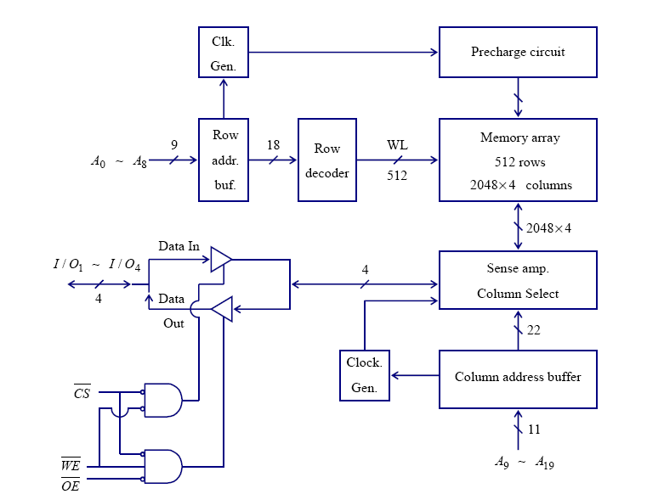
SRAM Architecture

Slide 26
Basic Memory Read Cycle
System selects memory with /CS=L
System presents correct address (A0-AN)
System turns o/p buffers on with /OE=L
System tri-states previous data sources within a permissible time limit (t_{OLZ} or t_{CLZ})
System must wait minimum time of t_{AA}, t_{AC} or t_{OE} to get correct data

Slide 27
Basic Memory Write Cycle
System presents correct address (A0-AN)
System selects memory with /CS=L
System waits a minimum time equal to internal setup time of new addresses (t_{AS})
System enables writing with /WE=L
System waits for minimum time to disable o/p driver (t_{wz})
System inputs data and waits minimum time (t_{DW}) for data to be written in core, then turns off write (/WE=H)

Slide 28
Memory Timing: Definitions

Slide 29
Memory Timing: Approaches

Slide 30
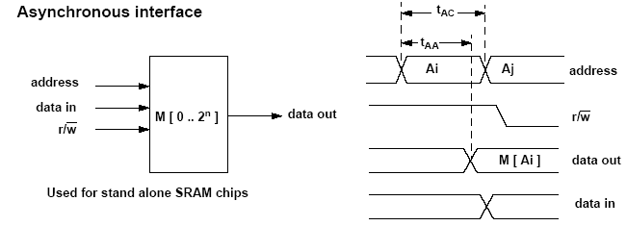
The system level view of Async SRAMs

Slide 31
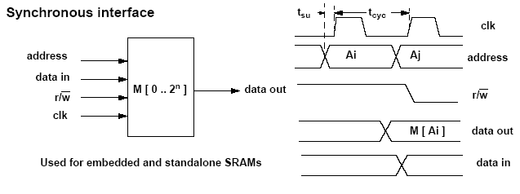
The system level view of synch SRAMs

Slide 32
Typical Async SRAM Timing
A
2
N
N
words
WE_L
x M bit
SRAM
OE_L
D
M
Write Timing:
Read Timing:
D
Data In
High Z
Data Out
Data Out
Junk
A
Write Address
Read Address
Read Address
OE_L
WE_L
Write
Hold Time
Read Access
Time
Read Access
Time
Write Setup Time
Notes:
For write, you set up your address and data on the A and D pins and then you generate a write pulse that is long enough for the write access time.
For simplicity, I have assumed the Write setup time for address and data to be the same. In real life, they can be different.
For read operation, you have disasserted Wr Enable and assert Output Enable. Since you are supplying garbage address here so as soon as you assert OE_L, you will get garbage out.
If you then present an valid address to the SRAM, valid data will be available at the output after a delay of the Write Access Time.
SRAM’s timing is much simpler than the DRAM timing which I will show you later.
+1 = 34 min. (Y:14)

Slide 33
SRAM Read Timing (typical)
t_{AA} (access time for address): how long it takes to get stable output after a change in address.
t_{ACS} (access time for chip select): how long it takes to get stable output after CS is asserted.
t_{OE} (output enable time): how long it takes for the three-state output buffers to leave the high- impedance state when OE and CS are both asserted.
t_{OZ} (output-disable time): how long it takes for the three-state output buffers to enter high- impedance state after OE or CS are negated.
t_{OH} (output-hold time): how long the output data remains valid after a change to the address inputs.

Slide 34
SRAM Read Timing (typical)
ADDR
stable
stable
stable
≥ t_{AA}
Max(t_{AA,} t_{ACS})
CS_L
t_{OH}
t_{ACS}
OE_L
t_{AA}
t_{OZ}
t_{OE}
t_{OZ}
t_{OE}
DOUT
valid
valid
valid
WE_L = HIGH

Slide 35
SRAM Architecture and Read Timings
tOH
tAA
tACS
tOZ
tOE

Slide 36
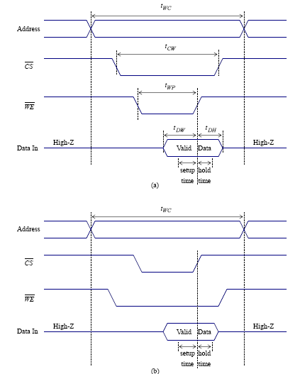
SRAM write cycle timing
/WE controlled
/CS controlled

Slide 37
SRAM Architecture and Write Timings
tDH
Setup time = tDW
Write driver
tWP-tDW

Slide 38
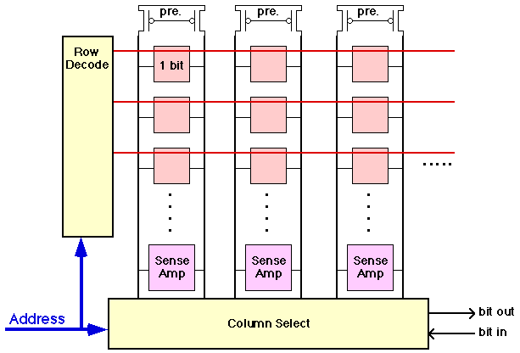
SRAM Array
SL0
SL1
SL2
Array Organization
common bit precharge lines
need sense amplifier

Slide 39
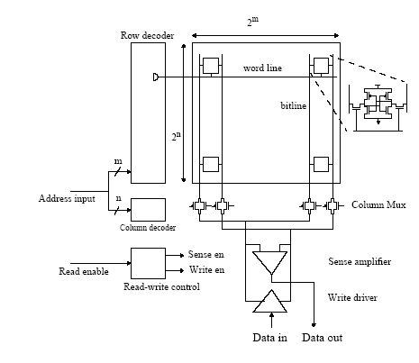
SRAM Architecture

Slide 40
SRAM Architecture

Slide 41
Simple 4x4 SRAM Memory
read precharge
bit line precharge
enable
2 bit width
M=2
A_R = 2
R = 2^{A_R} = 4
A_C = 1
C = 2^{A_C} x M = 4
N_ADDR = A_R + A_C = 3
Array size =
R x C = 16
WL[0]
BL
!BL
A₁
WL[1]
Row Decoder
A₂
WL[2]
WL[3]
A₀
Column Decoder
A₀!
clocking and control ->
sense amplifiers
WE! , OE!
write circuitry
Notes:
To decrease the bit line delay for reads – use low swing bit lines, i.e., bit lines don’t swing rail-to-rail, but precharge to Vdd (as 1) and discharge to Vdd – 10%Vdd (as 0). (So for 2.5V Vdd, 0 is 2.25V.) Requires sense amplifiers to restore to full swing.
Write circuitry – receives full swing from sense amps – or writes full swing to the bit lines

Slide 42
Simple 4x4 SRAM Memory
read precharge
bit line precharge
enable
2 bit width
M=2
A_R = 2
R = 2^{A_R} = 4
A_C = 1
C = 2^{A_C} x M = 4
N_ADDR = A_R + A_C = 3
Array size =
R x C = 16
WL[0]
BL
!BL
A₁
WL[1]
Row Decoder
A₂
WL[2]
WL[3]
A₀
Column Decoder
A₀!
clocking and control ->
sense amplifiers
WE! , OE!
write circuitry
Notes:
To decrease the bit line delay for reads – use low swing bit lines, i.e., bit lines don’t swing rail-to-rail, but precharge to Vdd (as 1) and discharge to Vdd – 10%Vdd (as 0). (So for 2.5V Vdd, 0 is 2.25V.) Requires sense amplifiers to restore to full swing.
Write circuitry – receives full swing from sense amps – or writes full swing to the bit lines

Slide 43
SRAM Cell Design
Memory array typically needs to store lots of bits
Need to optimize cell design for area and performance
Peripheral circuits can be complex
Smaller compared to the array (60-70% area in array, 30-40% in periphery)
Memory cell design
6T cell full CMOS
4T cell with high resistance poly load
TFT load cell

Slide 44
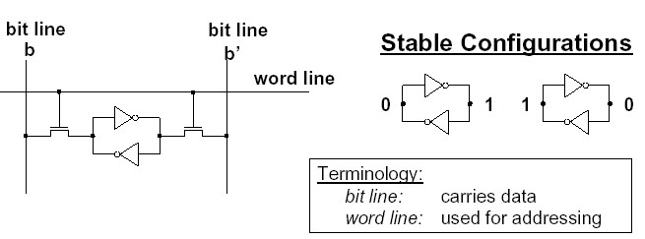
Anatomy of the SRAM Cell
->
Write:
set bit lines to new data value
b’ = opposite of b
raise word line to “high”
sets cell to new state
May need to flip old state
Read:
set bit lines high
set word line high
see which bit line goes low

Slide 45
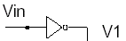
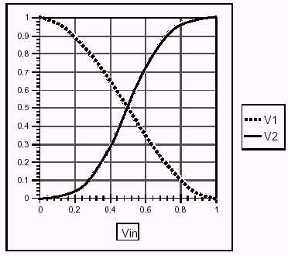
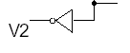
SRAM Cell Operating Principle
Inverter Amplifies
Negative gain
Slope < –1 in middle
Saturates at ends
Inverter Pair Amplifies
Positive gain
Slope > 1 in middle
Saturates at ends

Slide 46
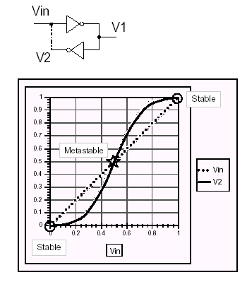
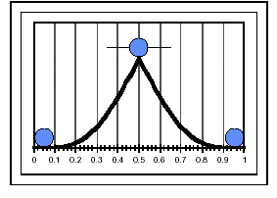
Bistable Element
Stability
§ Require Vin = V2
§ Stable at endpoints
recover from pertubation
§ Metastable in middle
Fall out when perturbed
Ball on Ramp Analogy

Slide 47
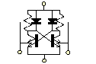
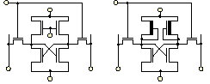
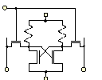
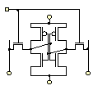
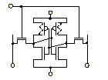
SRAM Cell technologies
Bipolar ECL : NPN with dual emitter
NMOS load
A) Enhancement : additional load gate bias
B) Depletion : no additional load gate bias
High Load
Resistance (4T)
Full CMOS
(6T)
Thin Film
Transistors

Slide 48
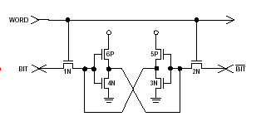
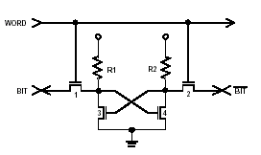
6T & 4T cell Implementation
6T Bistable Latch
High resistance poly
4T Bistable Latch

Slide 49
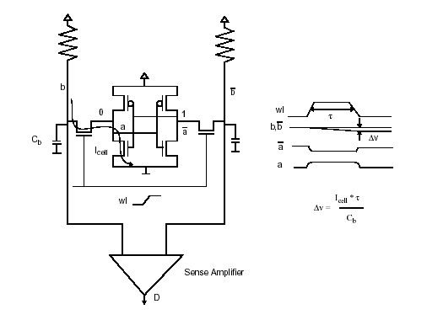
Reading a Cell
I_{cell}
ΔV = I_{cell *} τ
−−−−−
C_{b}
Sense Amplifier

Slide 50
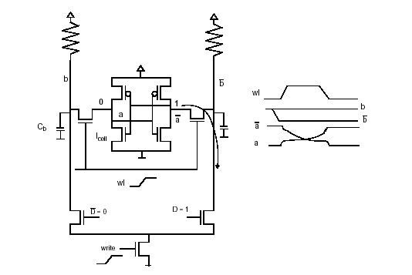
Writing a Cell
1 -> 0
0 -> 1

Slide 51
SRAM Cell Analysis (Read)
WL=1
M4
M6
!Q=0
M5
Q=1
M1
C_{bit}
C_{bit}
!BL=1
BL=1
Cell Ratio (CR) = (W_{M1}/L_{M1})/(W_{M5}/L_{M5})
V_{!Q} = [(V_{dd} - V_{Tn})(1 + CR ±√(CR(1 + CR))]/(1 + CR)
Notes:
M5 in saturation, M1 in linear mode

Slide 52
Read Voltages Ratios
V_{dd} = 2.5V
V_{Tn} = 0.5V
Notes:
To avoid read-disturb, the voltage on node !Q should remain below the trip point of the inverter pair for all process, noise, and operating conditions. CRs of no less than 1.2 (most microprocessor fabs use a minimum cell ratio of 1.25 to 2)
Simulations should be done at high Vdd and low VTn (and considering process variations and misalignments)

Slide 53
SRAM Cell Analysis (Write)
WL=1
M4
!Q=0
M6
M5
Q=1
M1
!BL=1
BL=0
Pullup Ratio (PR) = (W_{M4}/L_{M4})/(W_{M6}/L_{M6})
V_{Q} = (V_{dd} - V_{Tn}) ±√((V_{dd} – V_{Tn})² – (μ_{p}/μ_{n})(PR)((V_{dd} – V_{Tn} - V_{Tp})²)
Notes:
State shown is that before write takes effect (1 is stored, trying to write a 0)
In order to write the cell, the pass gate M6 must be more conductive than the M4 to allow node Q to be pulled to a value low enough for the inverter pair (M2/M1) to begin amplifying the new data.
The maximum ratio of the pullup size to that of the pass gate required to guarantee that the cell is writable – M6 in linear, M4 in saturation

Slide 54
Write Voltages Ratios
V_{dd} = 2.5V
|V_{Tp}| = 0.5V
μ_{p}/μ_{n} = 0.5
Notes:
In order to write the cell, node Q must be pulled to a value low enough to trip the inverter combination – so pulling Q below VTn (0.5V) is required.
The limiting case for the write operation occurs at high Vdd when the pfet is strong (mup high, VTp low) and the nfet is weak (mun low, VTn high)
Typicaly, the widths of the pullup devices are sized at or near process minimum. Longer than minimum channel lengths may also be emplyed to further reduce the pullup ratio. This is necessary since the read sizing of the SRAM cell dictates that the pass gate sizing should be minimized to prevent read disturbs.

Slide 55
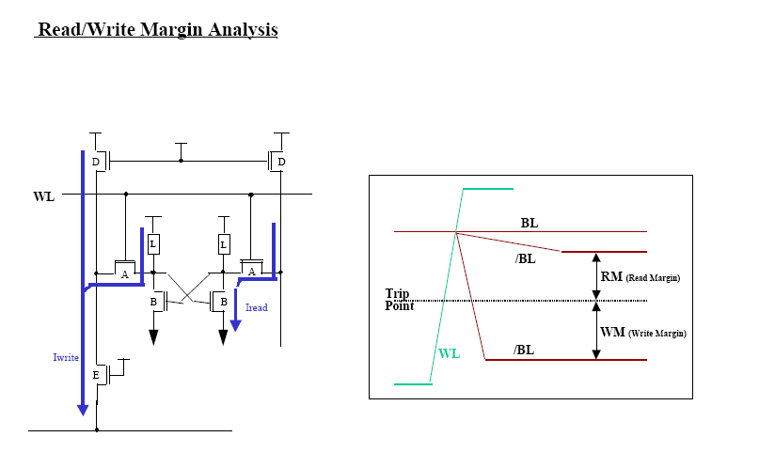

Slide 56
Cell Sizing
Keeping cell size minimized
Minimum sized pull down fets
Requires minimum width pull downs
longer than minimum length access transistors for CR
But upsizing access transistors increases capacitive load on the word lines
limits the current discharged on the bit lines
lowers speed of the read cycle
Minimum sized access transistors
Need to boost the width of the pull downs
Reduces the loading on the word lines
increases the storage capacitance in the cell
both are good! – but cell size may be slightly larger

Slide 57
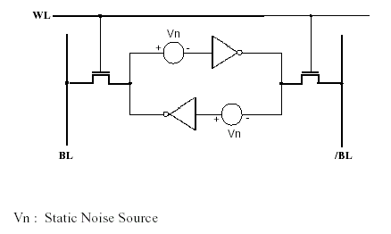
Cell Static Noise Margin
Cell state may be disturbed by
DC
Layout pattern offset
Process mismatches
non-uniformity of implantation
gate pattern size errors
AC
Alpha particles
Crosstalk
Voltage supply ripple
Thermal noise
SNM = Maximum Value of Vn
Without flipping cell state

Slide 58
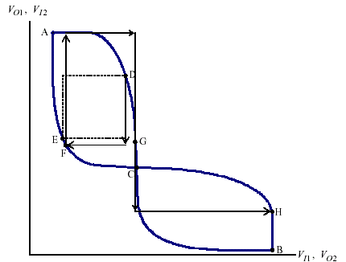
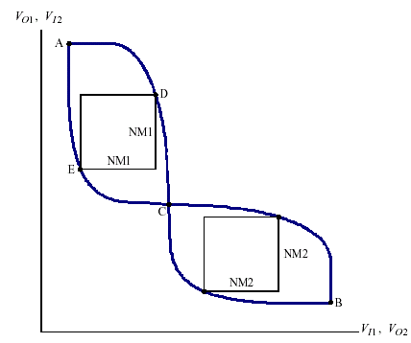
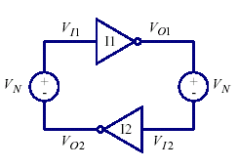
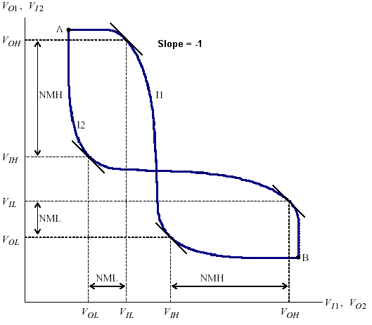
SNM: Butterfly Curves
1
SNM
2
2
SNM
1
2
1
1
2

Slide 59
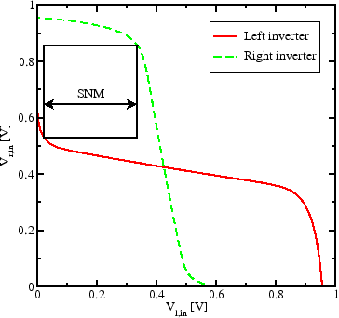
Static noise margin (SNM) of the unstressed SRAM cell.
The window in the ``butterfly'' curve
illustrates the hardiness against noise.
Figure of merit for an SRAM cell is its static noise margin (SNM).
It can be extracted by nesting the largest possible square in the two voltage transfer curves (VTC) of the involved CMOS inverters
The SNM is defined as the diagonal length of the square, given in volts.
When an external DC noise is larger than the SNM, the state of the SRAM cell can change and data is lost.

Slide 60
Static Noise Margin
SNM quantifies the amount of voltage noise required at the internal nodes of a bitcell to flip the cell’s contents.
Degraded SNM can limit voltage scaling for SRAM designs.
BL
WL
BLB
V_{N}
SNM is length of diagonal of the largest embedded square on the butterfly curve
M3
M6
M2
M5
Q
M1
M4
QB
V_{N}
Inverter 1
Inverter 2
[1]

Slide 61
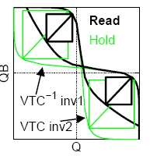
Cont’d
The minimum supply voltage of SRAMs is determined by both Read SNM and Write SNM levels; reducing Vth in the NMOS transistor improves Write SNM but worsens Read SNM.
Moves to the left
Moves upward
SNM Butterfly Curve
SNM is lower during read access because the VTC is degraded by the voltage divider across the access transistor (M2,M5) and drive transistor (M1,M4)[2]

Slide 62
SNM during HOLD and READ
BL
BLB
BL prech 1
BLB prech 1
WL=0
WL=1
M3
M6
M3
M6
M2
M5
M2
M1
M5
1
M4
0
[1]
M1
M4
1
0
Read SNM is worst-case

Slide 63
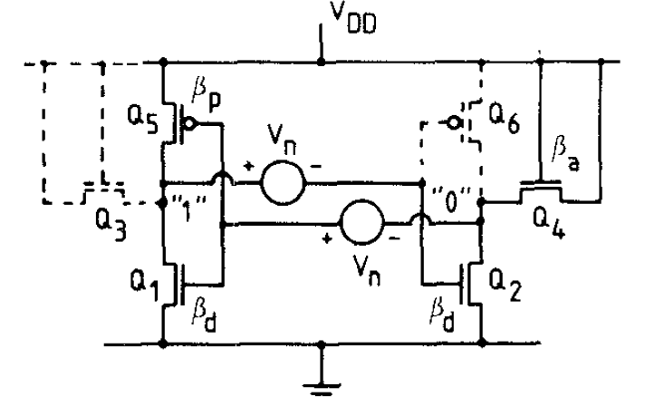
SNM Derivation 6T Cell
Lin
Sat
I_{Q1}=I_{Q5}
I_{Q2}=I_{Q4}
Sat
Lin

Slide 64
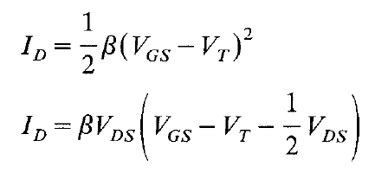
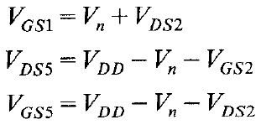
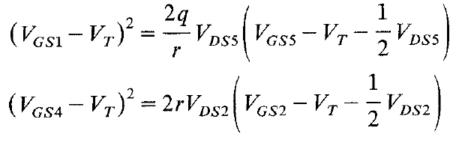
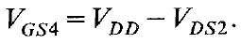
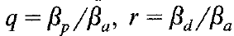
SNM Derivation 6T Cell (cont’d)
First order device model
Loop Voltage Eqns
Current Eqns
where

Slide 65
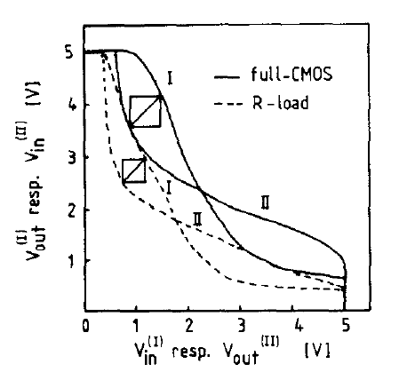
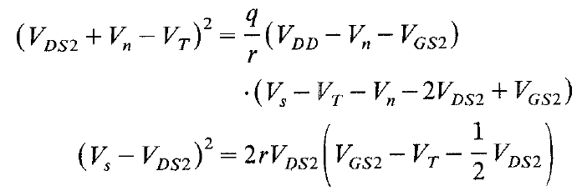
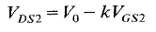
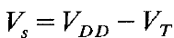
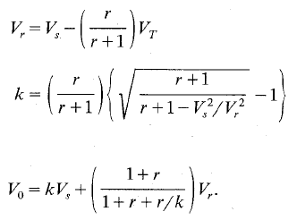
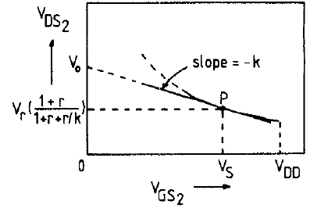
SNM Derivation 6T Cell (cont’d)
Substituting & Simplifying
where
Linearized
characteristics
where

Slide 66
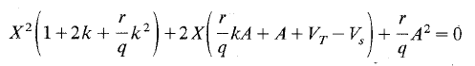
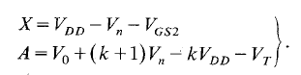
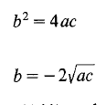
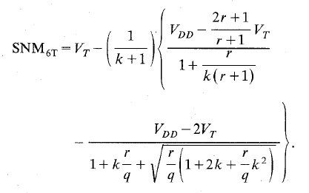
SNM Derivation 6T Cell (cont’d)
Eliminate V_{DS2}
where
Use identical root condn

Slide 67
References
Static-noise margin analysis of MOS SRAM cells E Seevinck, FJ List, J Lohstroh - Solid-State Circuits, IEEE Journal of, 1987 - ieeexplore.ieee.org
Analyzing Static Noise Margin for Sub-threshold SRAM in 65nm CMOS BH Calhoun, A Chandrakasan - www-mtl.mit.edu
The impact of intrinsic device fluctuations on CMOS SRAM cell stability AJ Bhavnagarwala, X Tang, JD Meindl - IEEE Journal of Solid-State Circuits, 2001 – ieeexplore.ieee.org
J. Lohstroh, E, Seevinck,, and J, de Groot, “Worst-case static noise margin criteria for logic clrcuils and their mathematical equivalence,” IEEE J. Solid-State Circuits, vol. SC-18, no. 6, pp. 803–807, Dec.1983,

Slide 68
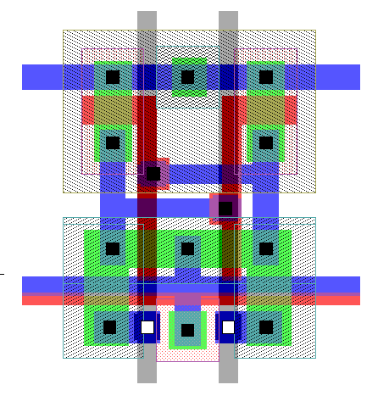
6T Cell Layout
B-
B+
N Well
Connection
V_{DD}
PMOS
Pull Up
Q/
Q
NMOS
Pull Down
GND
SEL
SEL MOSFET
Substrate
Connection

Slide 69


6T SRAM Array Layout

Slide 70
Another 6T Cell Layout Stick Diagram
bit
bit’
V_{DD}
T
T
T
T
T
T
word
Gnd
GND and contact shared with cell to left
These four contacts shared with (mirrored) cell below
2 Metal Layer Process

Slide 71
6T Array Layout (2x2) Stick Diagram
Gnd
bit
bit’
bit
bit’
V_{DD}
V_{DD}
Gnd
word
word
V_{DD}

Slide 72

6T Cell Full Layout
Transistor sizing
M₂ (pMOS) 4:3
M₁ (nMOS) 6:2
M₃ (nMOS) 4:2
All boundaries shared
38λ H x 28λ W
Reduced cap on bit lines
M₂
M₁
M₃

Slide 73
6T Cell – Example Layout & Abutment
Vdd
Vdd
T3
Vdd
Vdd
T3
Vss
T3
T4
T4
T4
T1
T1
T2
T2
Vss
Vss
Vss
T1
T5
Vdd
T6
T5
T6
T2
Vdd
Vdd
Vss
T4
T3
T4
T3
Vss
T1
T1
T2
Vss
T2
Vss
Vss
Vdd
T5
T6
T5
T6
T5
T6
B
B’
B’
B
B
4 x 4 array
2 x 2 abutment

Slide 74




6T and 4T Cell Layouts
Vdd
V_{DD}
R1
GND
T6
T5
BIT
T4
R2
BIT!
T3
Q
Q
T1
T2
T4
T3
Word
Line
GND
T1
T2
WL
BL
BL

Slide 75

6T - 4T Cell Comparison
6T cell
Merits
Faster
Better Noise Immunity
Low standby current
Demerits
Large size due to 6 transistors
4T cell
Merits
Smaller cell, only 4 transistors
HR Poly stacked above transistors
Demerits
Additional process step due to HR poly
Poor noise immunity
Large standby current
Thermal instability

Slide 76


6T vs 4T cell SNM

Slide 77

Transistor Level View of Core
Precharge
Row Decode
Column Decode
Sense Amp

Slide 78

SRAM, Putting it all together
2^{n} rows, 2^{m} * k columns
n + m address lines, k bits data width

Slide 79

Hierarchical Array Architecture
Subblocks
1 / output bit
Select 1 column / subblock
1 sense amp / subblock

Slide 80

Standalone SRAM Floorplan Example

Slide 81

Divided bit-line structure

Slide 82

SRAM Partitioning Partitioned Bitline

Slide 83

SRAM Partitioning Divided Wordline Arch

Slide 84
Partitioning summary
Partitioning involves a trade off between area, power and speed
For high speed designs, use short blocks(e.g 64 rows x 128 columns )
Keep local bitline heights small
For low power designs use tall narrow blocks (e.g 256 rows x 64 columns)

Slide 85
Address Transition Detection Provides Clock for Asynch RAMs

Slide 86
Row Decoders
Collection of 2^{R} complex logic gates organized in a regular, dense fashion
(N)AND decoder 9->512
WL(0) /= !A₈!A₇!A₆!A₅!A₄!A₃!A₂!A₁!A₀
…
WL(511) /= A₈A₇A₆A₅A₄A₃A₂A₁A₀
NOR decoder 9->512
WL(0) = !(A₈+A₇+A₆+A₅+A₄+A₃+A₂+A₁+A₀)
…
WL(511) = !(!A₈+!A₇+!A₆+!A₅+!A₄+!A₃+!A₂+!A₁+!A₀)

Slide 87
A NAND decoder using 2-input pre-decoders

Slide 88
Row Decoders (cont’d)
A0/ A1/ A0 A1/ A0/ A1 A0 A1 A2/ A3/ A2 A3/ A2/ A3 A2 A3
R0/
R1/
R2/
… and so forth
A0
A1
A2
A3

Slide 89
Dynamic Decoders

Slide 90
Dynamic NOR Row Decoder
V_{dd}
WL₀
WL₁
WL₂
WL₃
A₀
!A₀
A₁
!A₁
Precharge/
Notes:
Dynamic 2-to-4 NOR decoder – precharge all outputs high, then GND inactive outputs - active “high” output signals
Note that signal goes through at most one fet (so constant propagation delay (in theory)) – some output wires have two parallel paths to GND
Also note, that the capacitance of the output wires goes linearly with the decoder size (linear grow in fet diffusion capacitance)

Slide 91
Dynamic NAND Row Decoder
WL₀
WL₁
WL₂
WL₃
!A₀
A₀
!A₁
A₁
Precharge/
Back
Notes:
Dynamic 2-to-4 NAND decoder – precharge all outputs high, then discharge active output - active “low” output signals
Must ensure that all input signals are low during precharge – else Vdd and GND connected!
Note that the number of fets goes linearly with the decoder size – 2-to-4 has two fets in series, 3-to-8 has 3 fets in series, etc.- so will be slower than the NOR implementation if the gate capacitance dominates diffusion capacitance

Slide 92
Decoders
n:2^{n} decoder consists of 2^{n} n-input AND gates
One needed for each row of memory
Build AND from NAND or NOR gates
Make devices on address line minimal size
Scale devices on decoder O/P to drive word lines
Static CMOS Pseudo-nMOS

Slide 93

Row Decoders

Slide 94

Decoder Designs

Slide 95
Decoder Layout
Decoders must be pitch-matched to SRAM cell
Requires very skinny gates

Slide 96
Large Decoders
For n > 4, NAND gates become slow
Break large gates into multiple smaller gates

Slide 97
Predecoding
Group address bits in predecoder
Saves area
Same path effort

Slide 98
Split Row Decoder
!(!(!A₀!A₁!A₂) + !(!A₃!A₄!A₅) +!A₆)
WL₀
WL₀
*128
*128
WL₁₂₇
WL₁₂₇
!(!A₀!A₁!A₂)
. . .
!(A₀A₁A₂)
*8
*8
*7
Address<6:0>
*7
Notes:
Since address decoders need to interface with the core array cells, pitch matching with the core storage array can be difficult.
Can improve pitch and improve speed by splitting the decoder into smaller pieces.
Propagation delay reduced by a factor of 4 (# of inputs halved) – squared since dependency between delay and fan-in; and the load on the vertical address lines halved (also reducing the delay)
Also reduced the number of transistors – e.g., for a 10 input decoder with a 4-bit predecoder has 1024*6 (row decoder) + 5*4*4 (predecoder) = 6,224 as compared to 11*1024 = 11,264 yielding a 55% reduction
Address bit predecoded; the 18 lines of predecoded values are clocked and routed across the 128 array of final decoders. Each final decoder taps into one signal from each of the three sets to perform the final level of decoders.
Note that final row drivers have to drive a very long and heavily loaded word line, so have to drive them carefully (see lecture 24 – positioned in the center of the array, replicating circuitry at each end, strapping cells, etc.)

Slide 99
Sense Amplifier: Why?
Cell pull down
Xtor resistance
Bit line cap significant for large array
If each cell contributes 2fF,
for 256 cells, 512fF plus wire cap
Pull-down resistance is about 15K
RC = 7.5ns! (assuming ΔV = V_{dd})
Cannot easily change R, C, or V_{dd}, but can change ΔV i.e. smallest sensed voltage
Can reliably sense ΔV as small as <50mV
Cell current

Slide 100
Sense Amplifiers
make
Δ
V as small
C_{b}
⋅
Δ
V
as possible
t
p
=
----------------
I
cell
large
small
Idea: Use Sense Amplifer
small
transition
s.a.
input
output

Slide 101
Differential Sensing - SRAM
V
DD
V
DD
V
DD
PC
V
DD
y
M3
M4
y
x
M1
M2
x
x
x
BL
EQ
BL
SE
M5
SE
WL
i
(b) Doubled-ended Current Mirror Amplifier
SRAM cell i
V
DD
Diff.
y
y
x
Sense
x
y
Amp
y
x
x
D
D
SE
(a) SRAM sensing scheme.
(c) Cross-Coupled Amplifier

Slide 102
Latch-Based Sense Amplifier

Slide 103

Sense Amplifier
bit’
bit
word
sense
clk
isolation transistor
regenerative amplifier

Slide 104
Clocked Sense Amp
Clocked sense amp saves power
Requires sense_clk after enough bitline swing
Isolation transistors cut off large bitline capacitance

Slide 105
Alpha Differential Amplifier/Latch
S₃
column decoder
S₂
S₁
S₀
precharge
mux_out
!mux_out
0->1
sense
amplifier
P1
P2
N3
N5
sense
N2
N4
sense
N1
0->1
off->on
ΔV = V_{dd}
P3
P4
Pre -> Closed)
sense_out
!sense_out
Notes:
N2 and N4 sense the voltage change on the bit lines (gates are connected to the two bit lines coming from the column decoder)
N1 enables the SA by providing current to the two detection devices.
The cross-coupled inverter pair (P1/N3 and P2/N5) is used to amplify the detected voltage differential.
Finally, a set of inverters is used to buffer the output of the SA.
Operation begins with sense in low state. P3 and P4 precharge sense and !sense to Vdd and the bit lines gating N2 and N4 are precharged to Vdd. As the read begins one of the two input lines will begin to discharge and sense is asserted. This causes the pulldown N1 to turn on supplying current to the two legs of the SA.

Slide 106
Sense Amp Waveforms
1ns / div
bit
200mV
bit’
wordline↑
wordline↑
begin precharging bit lines
BIT
2.5V
BIT’
sense clk↑
sense clk↓

Slide 107


Slide 108


Slide 109

Sense Amp (Caveat)
For SRAM, one S/A for 4-8 columns
after column mux
For DRAM, one S/A for every column
for refresh!
Need to precharge S/A before opening isolation transistors
To avoid discharging bit lines
Requires 3 timing phases
Typically self-timed
Notes:
In the example waveform, we precharged S/A by opening isolation transistors (with wordline kept low). However, if wordline is high when isolation transistors open, then a bit line may be discharged prematurely.

Slide 110

Write Driver Circuits

Slide 111
Twisted Bitlines
Sense amplifiers also amplify noise
Coupling noise is severe in modern processes
Try to couple equally onto bit and bit_b
Done by twisting bitlines

Slide 112
Transposed-Bitline Architecture

Slide 113

2
1
4
3
6
5
7

Slide 114
Review of Memory Hierarchies
CPU
Cache
(SRAM)
Increasing Capacity
Physical Memory
Main Memory
(DRAM)
Increasing Speed
Virtual Memory
(Hard Disk)

Slide 115
Who Cares About the Memory Hierarchy?
Processor-DRAM Memory Gap (latency)
1000
µProc
60%/yr.
(2X/1.5yr)
CPU
“Moore’s Law”
100
Processor-Memory
Performance Gap: (grows 50% / year)
Performance
10
DRAM
9%/yr.
(2X/10 yrs)
DRAM
1
1980
1981
1982
1983
1984
1985
1986
1987
1988
1989
1990
1991
1992
1993
1994
1995
1996
1997
1998
1999
2000
Time
Notes:
Y-axis is performance
X-axis is time
Latency
Cliché:
Not e that x86 didn’t have cache on chip until 1989

Slide 116
Cache Memory Motivation
Processor speeds are increasing much faster than memory speeds
Memory speed matters
Each instruction / data needs to be fetched from memory
Loads, stores are a significant fraction of instructions
Amdahl’s Law tells us that increasing processor performance without speeding up memory won’t help much overall
Locality of references
Locations that are close together in the address space tend to get referenced close together in time (spatial locality)
Tend to reference the same memory locations over and over again (temporal locality)

Slide 117

Memory Reference Patterns
Bad locality behavior
Temporal
Locality
Memory Address (one dot per access)
Spatial
Locality
Time
Donald J. Hatfield, Jeanette Gerald: Program Restructuring for Virtual Memory. IBM Systems Journal 10(3): 168-192 (1971)

Slide 118
Caches
Caches exploit both types of predictability:
Exploit temporal locality by remembering the contents of recently accessed locations.
Exploit spatial locality by fetching blocks of data around recently accessed locations.
4/25/2014
CS252-Fall’07
118

Slide 119
Cache Memories
Relatively small SRAM memories located physically close to the processor
SRAMs have low access times
Physical proximity reduces wire delay
Similar in concept to virtual memory
Keep commonly-accessed data in smaller, fast memory
Inclusion property
Any data in a given level of the hierarchy must be contained in all levels below that in the hierarchy.
Means that we never have to worry about whether we have space for data we need to evict from one level into a lower level

Slide 120
Cache Operation
On memory access, look in the cache first
If the address we want is in the cache, complete the operation, usually in one cycle
If not, complete the operation using the main memory (many cycles)

Slide 121
Performance of Memory Hierarchies
Basic Formula:
T_{avg} = P_{hit} * T_{hit} + P_{miss} * T_{miss}
T_{hit} = time to complete the memory reference if we hit in a given level of the hierarchy
T_{miss} = time to complete the memory reference if we miss and have to go down to the next level
P_{hit}, P_{miss} = Probabilities of hitting or missing in the level
P_{hit} is always 100% for the bottom level of the hierarchy

Slide 122
Example 1
A memory system consists of a cache and a main memory. If it takes 1 cycle to complete a cache hit, and 100 cycles to complete a cache miss, what is the average memory access time if the hit rate in the cache is 97%?
Thit = 1 cycle
Tmiss = 100 cycles
Phit = .97
Pmiss = .03
T_{avg} = P_{hit} * T_{hit} + P_{miss} * T_{miss} = 0.97 * 1 + .03 * 100
= 3.97 cycles

Slide 123
Describing Caches
We characterize a cache using 5 parameters
Access Time: T_{hit}
Capacity: the total amount of data the cache can hold
# of lines * line length
Line Length / Block size: The amount of data that gets moved into or out of the cache as a chunk
Analogous to page size in virtual memory
What happens on a write?
Replacement Policy: What data is replaced on a miss?
Associativity: How many locations in the cache is a given address eligible to be placed in?
Unified, Instruction, Data: What type of data is kept in the cache?

Slide 124
Capacity
In general, bigger is better
The more data you can store in the cache, the less often you have to go out to the main memory
However, bigger caches tend to be slower
Need to understand how both T_{hit} and P_{hit} change as you change the capacity of the cache.
Declining return on investment as cache size goes up

Slide 125
Cache Line Length
Cache groups contiguous addresses into lines
Lines almost always aligned on their size
Caches fetch or write back an entire line of data on a miss
Spatial Locality
Reading/Writing a Line
Typically, takes much longer to fetch the first word of a line than subsequent words
Page Mode memories
T_{fetch} = T_{first} + (line length / fetch width) * T_{subsequent}

Slide 126
What causes a MISS?
4/25/2014
CS252-Fall’07
126
Three Major Categories of Cache Misses:
Compulsory Misses: first access to a block
Capacity Misses: cache cannot contain all blocks needed to execute the program
Conflict Misses: block replaced by another block and then later retrieved - (affects set assoc. or direct mapped caches)
Nightmare Scenario: ping pong effect!

Slide 127
Block Size and Spatial Locality
Block is unit of transfer between the cache and memory
4 word block, b=2
Tag
Word0
Word1
Word2
Word3
Split CPU address
block address offset_{b}
32-b bits
b bits
2^{b} = block size a.k.a line size (in bytes)
Larger block size has distinct hardware advantages
less tag overhead
exploit fast burst transfers from DRAM
exploit fast burst transfers over wide busses
What are the disadvantages of increasing block size?
Fewer blocks => more conflicts. Can waste bandwidth.
4/25/2014
CS252-Fall’07
127
Notes:
CS252 S05
127
Larger block size will reduce compulsory misses (first miss to a block).
Larger blocks may increase conflict misses since the number of blocks
is smaller.

Slide 128
Miss Rates Vs Block Size
4
0
%
3
5
%
3
0
%
e
2
5
%
t
a
r
s
2
0
%
s
i
M
1
5
%
1
0
%
5
%
0
%
4
1
6
6
4
2
5
6
B
l
o
c
k
s
i
z
e
(
b
y
t
e
s
)
1
K
B
8
K
B
Cache size
1
6
K
B
6
4
K
B
2
5
6
K
B

Slide 129
Hit Rate isn’t Everything
Average access time is better performance indicator than hit rate
T_{avg} = P_{hit} * T_{hit} + P_{miss} * T_{miss}
T_{miss} = T_{fetch} = T_{first} + (line length / fetch width) * T_{subsequent}
Trade-off: Increasing line length usually increases hit rate, but also increases fetch time
As lines get bigger, increase in fetch time starts to outweigh increase in miss rate

Slide 130
Block Size Tradeoff
In general, larger block size take advantage of spatial locality BUT:
Larger block size means larger miss penalty:
Takes longer time to fill up the block
If block size is too big relative to cache size, miss rate will go up
Too few cache blocks
In general, Average Access Time:
= Hit Time x (1 - Miss Rate) + Miss Penalty x Miss Rate
Average
Access
Time
Miss
Penalty
Miss
Rate
Exploits Spatial Locality
Increased Miss Penalty
& Miss Rate
Fewer blocks:
compromises
temporal locality
Block Size
Block Size
Block Size
Notes:
As I said earlier, block size is a tradeoff. In general, larger block size will reduce the miss rate because it take advantage of spatial locality.
But remember, miss rate NOT the only cache performance metrics. You also have to worry about miss penalty.
As you increase the block size, your miss penalty will go up because as the block gets larger, it will take you longer to fill up the block.
Even if you look at miss rate by itself, which you should NOT, bigger block size does not always win. As you increase the block size, assuming keeping cache size constant, your miss rate will drop off rapidly at the beginning due to spatial locality.
However, once you pass certain point, your miss rate actually goes up.
As a result of these two curves, the Average Access Time (point to equation), which is really the more important performance metric than the miss rate, will go down initially because the miss rate is dropping much faster than the increase in miss penalty.
But eventually, as you keep on increasing the block size, the average access time can go up rapidly because not only is the miss penalty is increasing, the miss rate is increasing as well.
Let me show you why your miss rate may go up as you increase the block size by another extreme example.
+3 = 33 min. (Y:13)

Slide 131
Basics of caches
How do we determine if the data is in the cache?
If data is in the cache, how is it found?
We only have information on:
address of data
how the cache is organised
Direct mapped cache:
the data can only be at a specific place

Slide 132
Data Address is used to organise cache storage strategy
Word is organised by byte bits
Block is organised by bits denoting the word
Location in cache is indexed by row
Tag is identification of a block in a cache row
Word address bits fields
Tag
Index
Block
Byte

Slide 133

Example 24 bit address with 8 byte block and 2048 blocks in cache of 16384 bytes

Slide 134
Where can a block be placed ?
Block 12 placed in 8 block cache:
Fully associative, direct mapped, 2-way set associative
S.A. Mapping = Block Number Modulo Number Sets
Fully associative:
block 12 can go anywhere
Set associative:
block 12 can go anywhere in set 0 (12 mod 4)
Direct mapped:
block 12 can go only into block 4 (12 mod 8)
Block
no.
0 1 2 3 4 5 6 7
Block
no.
0 1 2 3 4 5 6 7
Block
no.
0 1 2 3 4 5 6 7
Set
0
Set
1
Set
2
Set
3
Block-frame address
Block
no.
1 1 1 1 1 1 1 1 1 1 2 2 2 2 2 2 2 2 2 2 3 3
0 1 2 3 4 5 6 7 8 9 0 1 2 3 4 5 6 7 8 9 0 1 2 3 4 5 6 7 8 9 0 1

Slide 135
How is a block found if it is in the upper level?
Block Address
Block
offset
Tag
Index
Direct indexing (using index and block offset), tag compares, or combination
Increasing associativity shrinks index, expands tag

Slide 136
Contents of a direct mapped cache
Data == Cached block
TAG == Most significant bits of cached block address that identify the block in that cache row from other blocks that map to that same row
VALID == Flag bit to indicate the cache content is valid

Slide 137
Direct cache
ADDRESS
A
d
d
r
e
s
s
(
s
h
o
w
i
n
g
b
i
t
p
o
s
i
t
i
o
n
s
)
3
1
3
0
1
3
1
2
1
1
2
1
0
o
B
y
t
e
f
f
s
e
t
H
i
t
2
0
1
0
D
a
t
a
Separate address into fields:
Byte offset in word
Index for row of cache
Tag identifier of block
T
a
g
I
n
d
e
x
I
n
d
e
x
V
a
l
i
d
T
a
g
D
a
t
a
0
1
2
1
0
2
1
Cache of 2^n words, a block being a 4 byte word, has 2^n*(63-n) bits for 32 bit address
1
0
2
2
1
0
2
3
2
0
3
2
#rows=2^n
#bits/row=32+32-2-n+1=63-n

Slide 138
Example: 1 KB Direct Mapped Cache with 32 Byte Blocks
For a 2 ** N byte cache:
The uppermost (32 - N) bits are always the Cache Tag
The lowest M bits are the Byte Select (Block Size = 2 ** M)
31
9
4
0
Cache Tag
Example: 0x50
Cache Index
Byte Select
Ex: 0x01
Ex: 0x00
Stored as part
of the cache “state”
Valid Bit
Cache Tag
Cache Data
Byte 31
:
Byte 1
Byte 0
0
0x50
Byte 63
:
Byte 33
Byte 32
1
2
3
:
:
:
Byte 1023
:
Byte 992
31
Notes:
Let’s use a specific example with realistic numbers: assume we have a 1 KB direct mapped cache with block size equals to 32 bytes.
In other words, each block associated with the cache tag will have 32 bytes in it (Row 1).
With Block Size equals to 32 bytes, the 5 least significant bits of the address will be used as byte select within the cache block.
Since the cache size is 1K byte, the upper 32 minus 10 bits, or 22 bits of the address will be stored as cache tag.
The rest of the address bits in the middle, that is bit 5 through 9, will be used as Cache Index to select the proper cache entry.
+2 = 30 min. (Y:10)

Slide 139
Extreme Example: single big line
Valid Bit
Cache Tag
Cache Data
Byte 3
Byte 2
Byte 1
Byte 0
0
Cache Size = 4 bytes Block Size = 4 bytes
Only ONE entry in the cache
If an item is accessed, likely that it will be accessed again soon
But it is unlikely that it will be accessed again immediately!!!
The next access will likely be a miss again
Continually loading data into the cache but discard (force out) them before they are used again
Worst nightmare of a cache designer: Ping Pong Effect
Conflict Misses are misses caused by:
Different memory locations mapped to the same cache index
Solution 1: make the cache size bigger
Solution 2: Multiple entries for the same Cache Index
Notes:
Let’s go back to our 4-byte direct mapped cache and increase its block size to 4 byte. Now we end up have one cache entries instead of 4 entries.
What do you think this will do to the miss rate? Well the miss rate probably will go to hell. It is true that if an item is accessed, it is likely that it will be accessed again soon.
But probably NOT as soon as the very next access so the next access will cause a miss again. So what we will end up is loading data into the cache but the data will be forced out by another cache miss before we have a chance to use it again.
This is called the ping pong effect: the data is acting like a ping pong ball bouncing in and out of the cache. It is one of the nightmares scenarios cache designer hope never happens.
We also defined a term for this type of cache miss, cache miss caused by different memory location mapped to the same cache index. It is called Conflict miss.
There are two solutions we can use to reduce the conflict miss. The first one is to increase the cache size.
The second one is to increase the number of cache entries per cache index. Let me show you what I mean.
+2 = 35 min. (Y:15)

Slide 140
Another Extreme Example: Fully Associative
Fully Associative Cache, N blocks of 32 bytes each
Forget about the Cache Index
Compare the Cache Tags of all cache entries in parallel
Example: Block Size = 32 Byte blocks, we need N 27-bit comparators
31
4
0
Cache Tag (27 bits long)
Byte Select
Ex: 0x01
Cache Tag
Valid Bit
Cache Data
X
Byte 31
:
Byte 1
Byte 0
X
Byte 63
:
Byte 33
Byte 32
X
X
:
:
:
X
Notes:
While the direct mapped cache is on the simple end of the cache design spectrum, the fully associative cache is on the most complex end.
It is the N-way set associative cache carried to the extreme where N in this case is set to the number of cache entries in the cache.
In other words, we don’t even bother to use any address bits as the cache index.
We just store all the upper bits of the address (except Byte select) that is associated with the cache block as the cache tag and have one comparator for every entry.
The address is sent to all entries at once and compared in parallel and only the one that matches are sent to the output. This is called an associative lookup.
Needless to say, it is very hardware intensive. Usually, fully associative cache is limited to 64 or less entries.
Since we are not doing any mapping with the cache index, we will never push any other item out of the cache because multiple memory locations map to the same cache location.
Therefore, by definition, conflict miss is zero for a fully associative cache. This, however, does not mean the overall miss rate will be zero.
Assume we have 64 entries here. The first 64 items we accessed can fit in.
But when we try to bring in the 65th item, we will need to throw one of them out to make room for the new item. This bring us to the third type of cache misses: Capacity Miss.
+3 = 41 min. (Y:21)

Slide 141
A Two-way Set Associative Cache
N-way set associative: N entries for each Cache Index
N direct mapped caches operates in parallel
Example: Two-way set associative cache
Cache Index selects a “set” from the cache
The two tags in the set are compared in parallel
Data is selected based on the tag result
Cache Index
Valid
Cache Tag
Cache Data
Cache Data
Cache Tag
Valid
Cache Block 0
Cache Block 0
:
:
:
:
:
:
Adr Tag
Compare
Sel1
1
Mux
0
Sel0
Compare
OR
Cache Block
Hit
Notes:
This is called a 2-way set associative cache because there are two cache entries for each cache index. Essentially, you have two direct mapped cache works in parallel.
This is how it works: the cache index selects a set from the cache. The two tags in the set are compared in parallel with the upper bits of the memory address.
If neither tag matches the incoming address tag, we have a cache miss.
Otherwise, we have a cache hit and we will select the data on the side where the tag matches occur.
This is simple enough. What is its disadvantages?
+1 = 36 min. (Y:16)

Slide 142
DRAM in a nutshell
Based on capacitive (non-regenerative) storage
Highest density (Gb/cm2)
Large external memory (Gb) or embedded DRAM for image, graphics, multimedia…
Needs periodic refresh -> overhead, slower

Slide 143



Slide 144
Classical DRAM Organization (square)
bit (data) lines
r
o
w
d
e
c
o
d
e
r
Each intersection represents
a 1-T DRAM Cell
RAM Cell
Array
word (row) select
row
address
Column Selector &
I/O Circuits
Column
Address
Row and Column Address together:
Select 1 bit a time
data
Notes:
Similar to SRAM, DRAM is organized into rows and columns.
But unlike SRAM, which allows you to read an entire row out at a time at a word, classical DRAM only allows you read out one-bit at time time.
The reason for this is to save power as well as area. Remember now the DRAM cell is very small we have a lot of them across horizontally.
So it will be very difficult to build a Sense Amplifier for each column due to the area constraint not to mention having a sense amplifier per column will consume a lot of power.
You select the bit you want to read or write by supplying a Row and then a Column address.
Similar to SRAM, each row control line is referred to as the word line and each vertical data line is referred to as the bit line.
+2 = 57 min. (Y:37)

Slide 145

DRAM logical organization (4 Mbit)

Slide 146

DRAM physical organization (4 Mbit,x16)

Slide 147
Memory Systems
address
n
DRAM
Controller
DRAM
2^n x 1
chip
n/2
Memory
Timing
Controller
w
Bus Drivers
Tc = Tcycle + Tcontroller + Tdriver

Slide 148
Logic Diagram of a Typical DRAM
RAS_L
CAS_L
WE_L
OE_L
A
256K x 8
DRAM
D
9
8
Control Signals (RAS_L, CAS_L, WE_L, OE_L) are all active low
Din and Dout are combined (D):
WE_L is asserted (Low), OE_L is disasserted (High)
D serves as the data input pin
WE_L is disasserted (High), OE_L is asserted (Low)
D is the data output pin
Row and column addresses share the same pins (A)
RAS_L goes low: Pins A are latched in as row address
CAS_L goes low: Pins A are latched in as column address
RAS/CAS edge-sensitive
Notes:
Here is the logic diagram of a typical DRAM.
In order to save pins, Din and Dout are combined into a set of bidirectional pins so you need two pins Write Enable and Output Enable to control the D pins’ directions.
In order to further save pins, the row and column addresses share one set of pins, pins A whose function is controlled by the Row Address Strobe and Column Address Strobe pins both of which are active low.
Whenever the Row Address Strobe makes a high to low transition, the value on the A pins are latched in as Row address.
Whenever the Column Address Strobe makes a high to low transition, the value on the A pins are latched in as Column address.
+2 = 60 min. (Y:40)

Slide 149
DRAM Operations
Write
Charge bitline HIGH or LOW and set wordline HIGH
Read
Bit line is precharged to a voltage halfway between HIGH and LOW, and then the word line is set HIGH.
Depending on the charge in the cap, the precharged bitline is pulled slightly higher or lower.
Sense Amp Detects change
Explains why Cap can’t shrink
Need to sufficiently drive bitline
Increase density => increase parasitic capacitance
Word Line
C
. . .
Bit Line
Sense Amp

Slide 150
Key DRAM Timing Parameters
t_{RAC}: minimum time from RAS line falling to the valid data output.
Quoted as the speed of a DRAM
A fast 4Mb DRAM t_{RAC} = 60 ns
t_{RC}: minimum time from the start of one row access to the start of the next.
t_{RC} = 110 ns for a 4Mbit DRAM with a t_{RAC} of 60 ns
t_{CAC}: minimum time from CAS line falling to valid data output.
15 ns for a 4Mbit DRAM with a t_{RAC} of 60 ns
t_{PC}: minimum time from the start of one column access to the start of the next.
35 ns for a 4Mbit DRAM with a t_{RAC} of 60 ns

Slide 151
DRAM Read Timing
Every DRAM access begins at:
The assertion of the RAS_L
2 ways to read: early or late v. CAS
RAS_L
CAS_L
WE_L
OE_L
A
256K x 8
DRAM
D
9
8
DRAM Read Cycle Time
RAS_L
CAS_L
A
Row Address
Col Address
Junk
Row Address
Col Address
Junk
WE_L
OE_L
D
High Z
Junk
Data Out
High Z
Data Out
Read Access
Time
Output Enable
Delay
Early Read Cycle: OE_L asserted before CAS_L
Late Read Cycle: OE_L asserted after CAS_L
Notes:
Similar to DRAM write, DRAM read can also be a Early read or a Late read.
In the Early Read Cycle, Output Enable is asserted before CAS is asserted so the data lines will contain valid data one Read access time after the CAS line has gone low.
In the Late Read cycle, Output Enable is asserted after CAS is asserted so the data will not be available on the data lines until one read access time after OE is asserted.
Once again, notice that the RAS line has to remain asserted during the entire time. The DRAM read cycle time is defined as the time between the two RAS pulse.
Notice that the DRAM read cycle time is much longer than the read access time.
Q: RAS & CAS at same time? Yes, both must be low
+2 = 65 min. (Y:45)

Slide 152
DRAM Write Timing
Every DRAM access begins at:
The assertion of the RAS_L
2 ways to write: early or late v. CAS
RAS_L
CAS_L
WE_L
OE_L
A
256K x 8
DRAM
D
9
8
DRAM WR Cycle Time
RAS_L
CAS_L
A
Row Address
Col Address
Junk
Row Address
Col Address
Junk
OE_L
WE_L
D
Junk
Data In
Junk
Data In
Junk
WR Access Time
WR Access Time
Early Wr Cycle: WE_L asserted before CAS_L
Late Wr Cycle: WE_L asserted after CAS_L
Notes:
Let me show you an example. Here we are performing two write operation to the DRAM.
Setup/hold times in colar bars
Remember, this is very important. All DRAM access start with the assertion of the RAS line.
When the RAS_L line go low, the address lines are latched in as row address. This is followed by the CAS_L line going low to latch in the column address.
Of course, there will be certain setup and hold time requirements for the address as well as data as highlighted here.
Since the Write Enable line is already asserted before CAS is asserted, write will occur shortly after the column address is latched in. This is referred to as the Early Write Cycle.
This is different from the 2nd example I showed here where the Write Enable signal comes AFTER the assertion of CAS. This is referred to as a Later Write cycle.
Notice that in the early write cycle, the width of the CAS line, which you as a logic designer can and should control, must be as long as the memory’s write access time.
On the other hand, in the later write cycle, the width of the Write Enable pulse must be as wide as the WR Access Time.
Also notice that the RAS line has to remain asserted (low) during the entire access cycle.
The DRAM write cycle time is defined as the time between the two RAS pulse and is much longer than the DRAM write access time.
+3 = 63 min. (Y:43)

Slide 153
Key DRAM Timing Parameters
t_{RAC}: minimum time from RAS line falling to the valid data output.
Quoted as the speed of a DRAM
A fast 4Mb DRAM t_{RAC} = 60 ns
t_{RC}: minimum time from the start of one row access to the start of the next.
t_{RC} = 110 ns for a 4Mbit DRAM with a t_{RAC} of 60 ns
t_{CAC}: minimum time from CAS line falling to valid data output.
15 ns for a 4Mbit DRAM with a t_{RAC} of 60 ns
t_{PC}: minimum time from the start of one column access to the start of the next.
35 ns for a 4Mbit DRAM with a t_{RAC} of 60 ns

Slide 154
DRAM Performance
A 60 ns (t_{RAC}) DRAM can
perform a row access only every 110 ns (t_{RC})
perform column access (t_{CAC}) in 15 ns, but time between column accesses is at least 35 ns (t_{PC}).
In practice, external address delays and turning around buses make it 40 to 50 ns
Add the time to drive the addresses off the microprocessor & the memory controller overhead.
Drive parallel DRAMs, external memory controller, bus to turn around, SIMM module, pins…
180 ns to 250 ns latency from processor to memory is good for a “60 ns” (t_{RAC}) DRAM

Slide 155

DRAM Performance
Cycle Time
Access Time
Time
DRAM (Read/Write) Cycle Time >> DRAM (Read/Write) Access Time
­ 2:1; why?
DRAM (Read/Write) Cycle Time :
How frequent can you initiate an access?
DRAM (Read/Write) Access Time:
How quickly will you get what you want once you initiate an access?
DRAM Bandwidth Limitation:
Limited by Cycle Time

Slide 156
Refreshing Overhead
Leakage :
junction leakage exponential with temp!
2…8 msec @ 80⁰ C
Decreases noise margin, destroys info
All columns in a selected row are refreshed when read
Count through all row addresses once per 3 msec. (no write possible then)
Overhead @ 10nsec read time for 8192(rows)*8192(cols)=64Mb:
8192 (rows) *1e-8/3e-3= 2.7%
Requires additional refresh counter and I/O control

Slide 157
1-Transistor Memory Cell (DRAM)
Write:
1. Drive bit line
2.. Select row
Read:
1. Precharge bit line
2.. Select row
3. Cell and bit line share charges
Very small voltage changes on the bit line
4. Sense (fancy sense amp)
Can detect changes of ~1 million electrons
5. Write: restore the value
Refresh
1. Just do a dummy read to every cell.
row select
bit

Slide 158

DRAM architecture

Slide 159




Cell read

Slide 160


16k DRAM (Double Poly Cell)
MostekMK4116, introduced 1977
Address multiplex
Page mode
NMOS, 2P1M
Vdd=12v, Vcc=5v, Vbb=-5v (Vss=0v)
Vdd-Vt precharge, dynamic sensing

Slide 161


1M DRAM
Triple poly Planar cell, 3P1M
poly1 -gate, W/L
poly2 –plate
poly3 (polycide) -B/L
metal -W/L strap
Vdd/2 bitline reference, Vdd/2 cell plate

Slide 162

4M DRAM
3D stacked or trench cell
CMOS 4P1M
x16 introduced
Self Refresh
Build cell in vertical dimension -shrink area while maintaining 30fF cell capacitance

Slide 163




Slide 164



Stacked-Capacitor Cells
Poly plate
COB=Capacitor over bit
Hitachi 64Mbit DRAM Cross Section
Samsung 64Mbit DRAM Cross Section

Slide 165

Evolution of DRAM cell structures

Slide 166



Buried Strap Trench Cell

Slide 167

Process Flow of BEST Cell DRAM
· Array Buried N-Well
· Storage Trench Formation
· Node Dielectric (6nm TEQ.)
· Buried Strap Formation
· Shallow Trench Isolation Formation
· N- and P-Well Implants
· Gate Oxidation (8nm)
· Gate Conductor (N+ poly / WSi)
· Junction Implants
· Insulator Deposition and Planarization
· Contact formation
· Bitline (Metal 0) formation
· Via 1 / Metal 1 formation
· Via 2 / Metal 2 formation
Shallow Trench Isolation -> Replaces LOCOS isolation -> saves area by eliminating Bird’s Beak

Slide 168

Sense Amplifier

Slide 169


Slide 170

Example of Mitsubishi DRAM column

Slide 171

On-chip Voltage Generators
Power supplies
for logic and memory
precharge voltage
e.g VDD/2 for DRAM Bitline .
backgate bias
reduce leakage
WL select overdrive (DRAM)

Slide 172

Charge Pump Operating Principle
Vin
~ +Vin
+Vin
Charge Phase
Vin
dV
+Vin
dV
Discharge Phase
Vo
Vin = dV – Vin + dV +Vo
Vo = 2*Vin + 2*dV ~ 2*Vin

Slide 173

Voltage Booster for WL
Cf
CL
d
Vhi
dV
Vhi
Vcf(0) ~ Vhi
VGG=Vhi
+
VGG ~ Vhi + Vhi
Cf
CL
Vcf ~ Vhi

Slide 174

Body Effect Model
φ_{s} = surface potential at threshold
Depends on doping level N_{A}
And intrinsic carrier concentration n_{i}
γ = body effect coefficient

Slide 175

Backgate bias generation
Use charge pump
Backgate bias:
Increases Vt -> reduces leakage
• reduces Cj of nMOST when applied to p-well (triple well process!),
smaller Cj -> smaller Cb → larger readout ΔV

Slide 176

Vdd / 2 Generation
2v
1v
1.5v
0.5v
~1v
1v
0.5v
0.5v
1v
Vtn = |Vtp|~0.5v
uN = 2 uP

Slide 177
DRAM technological requirements
Unlike SRAM : large Cb must be charged by small sense FF. This is slow.
Make Cb small: backbias junction cap., limit blocksize,
Backbias generator required. Triple well.
Prevent threshold loss in wl pass: VG > Vccs+VTn
Requires another voltage generator on chip
Requires VTnwl> Vtnlogic and thus thicker oxide than logic
Better dynamic data retention as there is less subthreshold loss.
DRAM Process unlike Logic process!
Must create “large” Cs (10..30fF) in smallest possible area
(-> 2 poly-> trench cap -> stacked cap)

Slide 178
Refreshing Overhead
Leakage :
junction leakage exponential with temp!
2…8 msec @ 80⁰ C
Decreases noise margin, destroys info
All columns in a selected row are refreshed when read
Count through all row addresses once per 3 msec. (no write possible then)
Overhead @ 10nsec read time for 8192*8192=64Mb:
8192*1e-8/3e-3= 2.7%
Requires additional refresh counter and I/O control

Slide 179

Dummy Cell on BL’

Slide 180
Differential Operation in DRAM with Vdd/2 precharge
• Sense amplifier works only for differential signal on B and B’ and rejects interference signals
• In differential circuit
Each bit line split into two identical halves
Each half-line connected to half of cells in column and additional dummy cell with storage capacitance Cd=Cs
– Upon selecting word line on the left side, dummy right cell (controlled by clk’d) is selected and vv.
Dummy cell is other half of differential DRAM cell
• Operation of differential circuit
Two halves of Bitline Bk and Cd of two dummy cells precharged to VDD/2
Upon selection of word line, appropriate dummy cell activated by rising clkd (clk’d)
Voltage increment (above VDD/2) on half-line connected to selected cell
dV(1) when 1 stored in cell, dV(0) otherwise

Slide 181
DRAM technological requirements
Unlike SRAM : large Cb must be charged by small sense FF. This is slow.
Make Cb small: backbias junction cap., limit blocksize,
Backbias generator required. Triple well.
Prevent threshold loss in wl pass: VG > Vccs+VTn
Requires another voltage generator on chip
Requires VTnwl> Vtnlogic and thus thicker oxide than logic
Better dynamic data retention as there is less subthreshold loss.
DRAM Process unlike Logic process!
Must create “large” Cs (10..30fF) in smallest possible area
(-> 2 poly-> trench cap -> stacked cap)

Slide 182
Refreshing Overhead
Leakage :
junction leakage exponential with temp!
2…8 msec @ 80⁰ C
Decreases noise margin, destroys info
All columns in a selected row are refreshed when read
Count through all row addresses once per 3 msec. (no write possible then)
Overhead @ 10nsec read time for 8192*8192=64Mb:
8192*1e-8/3e-3= 2.7%
Requires additional refresh counter and I/O control

Slide 183
Dummy Cell on BL’

Slide 184
Differential Operation in DRAM with Vdd/2 precharge
• Sense amplifier works only for differential signal on B and B’ and rejects interference signals
• In differential circuit
Each bit line split into two identical halves
Each half-line connected to half of cells in column and additional dummy cell with storage capacitance Cd=Cs
– Upon selecting word line on the left side, dummy right cell (controlled by clk’d) is selected and vv.
Dummy cell is other half of differential DRAM cell
• Operation of differential circuit
Two halves of Bitline Bk and Cd of two dummy cells precharged to VDD/2
Upon selection of word line, appropriate dummy cell activated by rising clkd (clk’d)
Voltage increment (above VDD/2) on half-line connected to selected cell
dV(1) when 1 stored in cell, dV(0) otherwise

Slide 185

Dummy cells
½ Bitline
½ Bitline
Vdd/2
precharge
Vdd/2
precharge
Additional wire &
Contact in cell
Wordline

Slide 186

Alternative Sensing Strategy Decreasing C_{dummy}
Convert to differential sense
Create a reference in an identical structure
Needs
A method of generating ½ signal swing of bit line
Operation:
Dummy cell is ½ C
active wordline and dummy wordline on opposite sides of sense amp.
Amplify difference
BL’
BL
So Small Cs small swing, Large Cb small swing
Overhead of fabricating C/2

Slide 187

Alternative Sensing Strategy Increasing C_{bitline} on Dummy side
Double Bitline
Data
Dummy
SA outputs D and D pre-charged to VDD through Q1, Q2 (Pr=1)
•reference capacitor, Cdummy, connected to a pair of matched bit lines and is at 0V (Pr=0)
•parasitic cap Cp2 on BL’ is ~ 2 Cp1 on BL,
sets up a differential voltage LHS vs. RHS due to rise time difference
SA outputs (D, D) become charged, with a small difference LHS vs. RHS
Regenerative Action of Latch

Slide 188


Slide 189


Slide 190
Cell Array and Circuits
1 Transistor 1 Capacitor Cell
Array Example
Major Circuits
・Sense amplifier
・Dynamic Row Decoder
・Wordline Driver
Other interesting circuits ・
Data bus amplifier ・
Voltage Regulator
Reference generator
Redundancy technique
High speed I/O circuits

Slide 191

Standard DRAM Array Design Example

Slide 192

WL direction
(row)
64K cells
(256x256)
Global WL decode + drivers
1M cells =
64Kx16
Column predecode
Local WL
Decode
BL direction (col)
SA+col mux

Slide 193

DRAM Array Example (cont’d)
2048 SA (Lower + Upper)
256x256
64
256
512K Array Nmat=16 ( 256 WL x 2048 SA)
Interleaved S／A & Hierarchical Row Decoder/Driver
(shared bit lines are not shown)

Slide 194
DRAM Performance
Cycle Time
Access Time
Time
Ratio of DRAM (Read/Write) Cycle Time to DRAM (Read/Write) Access Time
­ 2:1; why?
DRAM (Read/Write) Cycle Time :
How frequent can you initiate an access?
DRAM (Read/Write) Access Time:
How quickly will you get what you want once you initiate an access?
DRAM Bandwidth Limitation:
Limited by Cycle Time

Slide 195


Slide 196


Slide 197


Slide 198


Slide 199


Slide 200


Slide 201


Slide 202


Slide 203


Slide 204
Fast Memory Systems: DRAM specific
Multiple column accesses per RAS: page mode
DRAM buffers a row of bits inside the DRAM for column access (e.g., 16 Kbits row for 64 Mbits DRAM)
Allow repeated column access without another row access
64 Mbit DRAM: cycle time = 90 ns, optimized access = 25 ns
New DRAMs:
Synchronous DRAM: Provide a clock signal to DRAM, transfer synchronous to system clock
RAMBUS: startup company; reinvent DRAM interface
Each chip a module vs. slice of memory
Short bus between CPU and chips
Does own refresh
Variable amount of data returned
1 byte / 2 ns (500 MB/s per chip)

Slide 205
Page Mode DRAM: Motivation
Column
Address
Regular DRAM Organization:
N rows x N column x M-bit
Read & Write M-bit at a time
Each M-bit access requires a RAS / CAS cycle
Fast Page Mode DRAM
N x M “register” to save a row
N cols
DRAM
Row
Address
N rows
M bits
M-bit Output
1st M-bit Access
2nd M-bit Access
RAS_L
CAS_L
A
Row Address
Col Address
Junk
Row Address
Col Address
Junk

Slide 206
Fast Page Mode Operation
Column
Address
Fast Page Mode DRAM
N x M “SRAM” to save a row
After a row is read into the register
Only CAS is needed to access other M-bit blocks on that row
RAS_L remains asserted while CAS_L is toggled
N cols
DRAM
Row
Address
N rows
N x M “SRAM”
M bits
M-bit Output
1st M-bit Access
2nd M-bit
3rd M-bit
4th M-bit
RAS_L
CAS_L
A
Row Address
Col Address
Col Address
Col Address
Col Address

Slide 207
Page Mode DRAM Bandwidth Example
Page Mode DRAM Example:
16 bits x 1M DRAM chips (4 nos) in 64-bit module (8 MB module)
60 ns RAS+CAS access time; 25 ns CAS access time
Latency to first access=60 ns Latency to subsequent accesses=25 ns
110 ns read/write cycle time; 40 ns page mode access time ; 256 words (64 bits each) per page
Bandwidth takes into account 110 ns first cycle, 40 ns for CAS cycles
Bandwidth for one word = 8 bytes / 110 ns = 69.35 MB/sec
Bandwidth for two words = 16 bytes / (110+40 ns) = 101.73 MB/sec
Peak bandwidth = 8 bytes / 40 ns = 190.73 MB/sec
Maximum sustained bandwidth = (256 words * 8 bytes) / ( 110ns + 256*40ns) = 188.71 MB/sec

Slide 208

DRAM Memory Systems
address
n
DRAM
Controller
DRAM
2^n x 1
chip
n/2
Memory
Timing
Controller
w
Bus Drivers
Tc = Tcycle + Tcontroller + Tdriver

Slide 209

DRAM Performance
Wide:
CPU/Mux 1 word; Mux/Cache, Bus, Memory N words (Alpha: 64 bits & 256 bits)
Interleaved:
CPU, Cache, Bus 1 word: Memory N Modules (4 Modules); example is word interleaved
Simple:
CPU, Cache, Bus, Memory same width (32 bits)

Slide 210
Increasing Bandwidth - Interleaving
Access Pattern without Interleaving:
CPU
Memory
D1 available
Start Access for D1
Start Access for D2
Memory
Bank 0
Access Pattern with 4-way Interleaving:
Memory
Bank 1
CPU
Memory
Bank 2
Memory
Bank 3
Access Bank 1
Access Bank 0
Access Bank 2
Access Bank 3
We can Access Bank 0 again

Slide 211


Slide 212


Slide 213


Slide 214


Slide 215


Slide 216


Slide 217


Slide 218


Slide 219
Non Volatile Memories

Slide 220
Non Volatile memory types

Slide 221
Read-Only Memory Cells
BL
BL
BL
V_{DD}
WL
WL
WL
1
BL
BL
BL
WL
WL
WL
0
GND
Diode ROM
MOS ROM 1
MOS ROM 2
Absence/presence of transistor determines 1/0 or v.v.

Slide 222
MOS NOR ROM
V
DD
Pull-up devices
WL
[0]
GND
WL
[1]
WL
[2]
GND
WL
[3]
BL
[0]
BL
[1]
BL
[2]
BL
[3]
Presence of transistor at data bit = 0

Slide 223
Precharged MOS NOR ROM
f
pre
V
DD
Precharge devices
WL
[0]
GND
WL
[1]
WL
[2]
GND
WL
[3]
BL
[0]
BL
[1]
BL
[2]
BL
[3]
PMOS precharge device can be made as large as necessary,
but clock driver becomes harder to design.
Presence of transistor at data bit = 0

Slide 224
MOS NOR ROM Layout
BL[0]
BL[1]
BL[2]
BL[3]

Slide 225
MOS NOR ROM Layout
Presence of Implant == Absence of transistor

Slide 226
MOS NAND ROM
V
DD
Pull-up devices
BL
[0]
BL
[1]
BL
[2]
BL
[3]
/WL
[0]
WL are active low
/WL
[1]
/WL
[2]
/WL
[3]
All word lines high by default with exception of selected row
Presence of transistor at data bit = 1

Slide 227
MOS NAND ROM Layout
BL[0]
BL[1]
BL[2]
BL[3]
Implant fixed by mask.
Can it be made dynamic??
Presence of Implant == Absence of transistor

Slide 228


Slide 229
Non-Volatile Memories The Floating-gate transistor (FAMOS)
Floating gate
Gate
D
Source
Drain
t
ox
G
t
ox
+
+_
S
n
p
n
Substrate
Device cross-section
Schematic symbol

Slide 230
Floating-Gate Transistor Programming
20 V
0 V
5 V
10 V
5 V
20 V
5 V
0 V
2.5 V
5 V
S
D
S
D
S
D
Avalanche injection
Removing programming
voltage leaves charge trapped
Programming results in
higher
V
T
.

Slide 231
Floating gate Transistor
Cpp
Cfd
Cfs
Cf
Ctot = Cpp + Cf
Cox lower,so slope reduced
Cox lower, Vt higer,
curve shifts right
ΔVt = Qfg / Cpp
Qfg !=0, Vt increases further
Curve shifts further

Slide 232



Sensing Thresholds
Multi Bit / Multi Level Cell

Slide 233


Slide 234
Floating Gate Memory Cells
EPROM
UV erasable
EEPROM
Electrically erasable, can be read/written/erased/ on byte/word basis
Flash memory
Also called flash EEPROM
Can be cleared to 0/1 on a block basis
Bytes can be written inside block
By flipping some of the cleared cells

Slide 235

Floating Gate Program/Erase

Slide 236






Basic Floating-Gate Transistor: Weight Change Mechanisms
pFET Floating-Gate Synapse
Change floating-gate charge
using:
Tunneling Current
Injection Current
Notes:
The third term now shows up as an adaptive scale factor in the bias current, as well as an adaptive scale factor modulating the transconductance.
So now, how do we adapt the charge on the floating-gate if there are no conductive paths connecting it to anything?
We take advantage of two processes from the device physics: electron tunneling, which allows us to add charge to the floating-gate, and hot-electron injection which allows us to remove charge from the floating-gate.
These two processes are described by currents dependent on tunneling and injection.
For continuous-time adaptation, we fix the tunneling current to a bias value, and allow the injection current to vary around this operating point.
The dynamics of the floating-gate voltage can be determined by writing KCL at the floating-node. We will separate this differential equation into fast and slow timescales such that we can ignore Vg dot and Vd dot...

Slide 237

Modify Floating-gate Information
Information storage
Three methods of modification
UV photo injection
Electron tunneling
Hot-electron injection
Access Gate

Slide 238

Modify Floating-gate Information
Methods for changing information
UV photo injection
Electron tunneling
Hot-electron injection
Access Gate
Requires costly package
Programming time is lengthy
Difficult to selectively program
Perfect for normalizing arrays.
Notes:
Examine the methods of charge change and generally exclude UV injection due to costs.

Slide 239


Slide 240

Modify Floating-gate Information
Methods for changing information
UV photo injection
Electron tunneling
Hot-electron injection
Access Gate
Fowler-Nordheim Tunneling
field-assisted electron tunneling
electrons are waves too!
Notes:
Examine the methods of charge change and generally exclude UV injection due to costs.

Slide 241

Transistor Leakage Mechanisms
1. pn Reverse Bias Current
2. Subthreshold (Weak Inversion)
3. Drain Induced Barrier Lowering
4. Gate Induced Drain Leakage
5. Punchthrough
6. Narrow Width Effect
7. Hot Carrier Injection
8. Gate Oxide Tunneling
Utilised to
Prog/Erase
EEPROMs
Rev biased
Junc Band to
Band Tunneling
(BTBT)

Slide 242
Gate Oxide Tunneling
Fowler-Nordheim tunneling
high electric field across thin gate oxide layer
In oxide layers less than 3–4 nm thick
direct tunneling through the silicon oxide layer
Mechanisms
Electron tunneling in the conduction band (ECB)
Electron tunneling in the valence band (EVB)
Hole tunneling in the valence band (HVB)

Slide 243

Components of Gate Oxide Tunneling

Slide 244


Fowler Nordheim Tunneling
FN Tunneling
Gate-Source
FN Tunneling
Gate-Bulk
bulk
Igs
5v
float
-12v
Igb
0v
12v
0v
12v
float
float

Slide 245






Electron Tunneling
Vtun
Increasing the applied voltage decreases the effective barrier width
The range of tunneling currents span many orders of magnitude.

Slide 246
What governs tunneling rate?
Oxide Thickness
Field applied across the oxide.
V_{tun} ~ 30v for 2.0um
V_{tun} ~ 20v for 1.2um
V_{tun} ~ 15v for .5um
V_{tun} ~ 12v for .3um
FLASH

Slide 247


Slide 248

EEPROMS
EEPROMS allow transport of electrons to and from gate
Oxide between floating gate and channel in thinned out partially
To enhance tunneling
FLOTOX process
Floating Gate Tunneling Oxide
Poly2 makes control gate and wordline poly

Slide 249
FLOTOX EEPROM
Floating gate
Gate
I
Source
Drain
20
–
30 nm
-10 V
V
GD
10 V
n
1
Substrate
n
1
p
10 nm
Fowler-Nordheim I-V characteristic
FLOTOX transistor

Slide 250
Double Poly EEPROM cell

Slide 251

FLOTOX EEPROM Array
Program
FNT
Bytewise / wordwise
Byte Select = Vpp
W/L = Vpp
B/Ls = 0v
Vpp
Vdd/2
0v
0v
Vdd
Vpp
Vpp-Vt
0v
Erase
FN Tunneling
Bytewise / wordwise / Pagewise
Byte Select = 0v
W/L = Vpp
B/Ls = Vpp
Vpp-Vt
0v
FNT
FNT
Write = Erase then Program
Read – BL=Vdd/2 , WL = Vdd, Byte Sel = Vdd

Slide 252
Flash EEPROM
Control gate
Floating gate
erasure
Thin tunneling oxide
n
1
source
n
1
drain
programming
p-
substrate
Many other options …

Slide 253


Slide 254


Slide 255

Cross-sections of NVM cells
Flash
EPROM
Courtesy Intel

Slide 256


Slide 257


Slide 258


Slide 259


Slide 260


Slide 261


Slide 262


Slide 263


Slide 264


Slide 265


Slide 266



Slide 267

8Mb core

Slide 268
FLOTOX EEPROM Array
Program
FNT
Bytewise / wordwise
Byte Select = Vpp
W/L = Vpp
B/Ls = 0v
Vpp
Vdd/2
0v
0v
Vdd
Vpp
Vpp-Vt
0v
Erase
FN Tunneling
Bytewise / wordwise / Pagewise
Byte Select = 0v
W/L = Vpp
B/Ls = Vpp
Vpp-Vt
0v
FNT
FNT
Write = Erase then Program
Read – BL=Vdd/2 , WL = Vdd, Byte Sel = Vdd

Slide 269
Flash EEPROM
Control gate
Floating gate
erasure
Thin tunneling oxide
n
1
source
n
1
drain
programming
p-
substrate
Many other options …

Slide 272
Cross-sections of NVM cells
Flash
EPROM
Courtesy Intel

Slide 284
8Mb core

Slide 285

NAND
String
Erased = 0, Programmed = 1
WL is active low, erased cell Xtor is always on, programmed cell Xtor is off

Slide 286

NOR- and NAND-type Flash cell comparison

Slide 287


Slide 288


16 cells
Bitline

Slide 289


Slide 290


Slide 291


Program Inhibit Schemes (Basic)
0v
8v
VPass=10v
VPass=10v
Programmed cell
FN Tunneling enabled
VPGM=18v
Unprogrammed cell
FN Tunneling inhibited
VPass=10v
0V
0V

Slide 292


Slide 293


Slide 294

SA

Slide 295



Slide 296


NAND Flash Pinout
No ADDR / DATA pins??

Slide 297

NAND Flash Connectivity to System
CPU
ADDR, Data,
Command

Slide 298


Slide 299

NAND Flash Page Read
Command
Phase
Address
Phase
Data Xfer
Phase
(Long ~25us)
Readout
Phase
One data / pulse

Slide 300

NAND Flash Page Program
Check
Timeout
Command
Phase
Address
Phase
Data I/P
Phase
One data / pulse
Program
Phase
Long ~ 250uS

Slide 301

Array Organization – Logical View
ECC
Cell -> Byte / Word -> Page -> Block
Entire Page Programmed / Read at one time

Slide 302
Advantages of Page / Block Organisation
Eg : Page = 2KB, Block = 128Kb
The effective read speed of the large page NAND devices is similar to the small block devices:
Read Time = 6 cycles x 50ns(command) + 25 µs(data xfer) + 2112 cycles x 50ns(readout) = 131 µs
Read Speed = 2112 bytes / 131 µs = 16.1 Mbytes /sec
The effective write speed of the large page NAND devices is more than 3 times faster.
Write Time = 5 cycles x 50ns + 2112 cycles x 50ns + 1 cycle x 50ns + 200µs = 306 µs
Write Speed = 2112 bytes / 306µs = 6.9 Mbytes / sec
The effective erase speed is nearly 8 times faster.
Erase Time = 4 cycles x 50ns + 2ms = 2ms
Erase Speed = 128kB / 2ms = 64 Mbytes / sec

Slide 303

128Mb NAND Flash Functional Block Diagram

Slide 304

Block
32 pages
512Kbits
32
All cells
on one WL
form a page
Programmed
Together
2112x8 cells
Per phys page
Read data
½ Phys page
LH ½ phys page + RH ½ phys page =
1 logical page
8k+256
bits
8k+256
bits
Write data
½ Phys page

Slide 305

BL Direction
WL Direction
Global WL Decs
WL Direction
BL Direction
Block
SA

Slide 306
125mm2 1Gbit NAND Flash Memory
Technology 0.13µm p-sub CMOS triple-well
1poly, 1polycide, 1W, 2Al
Cell size 0.077µm2
Chip size 125.2mm2
Organization 2112 x 8b x 64 pages x 1k blocks
Page = 16Kb (2KB) data 512b ECC, 1 ECC bit / 32 data bits
Power supply 2.7V-3.6V
Cycle time 50ns
Read time 25µs
Program time 200µs / page
Erase time 2ms / block

Slide 307



Slide 308


Slide 309


Slide 310


Slide 311


Slide 312

Features of NAND- and NOR-type FLASH

